Slide 1

far

Slide 2

far
WIFI Name World Climate Summit
Password TheInvestmentCOP2023

Slide 3
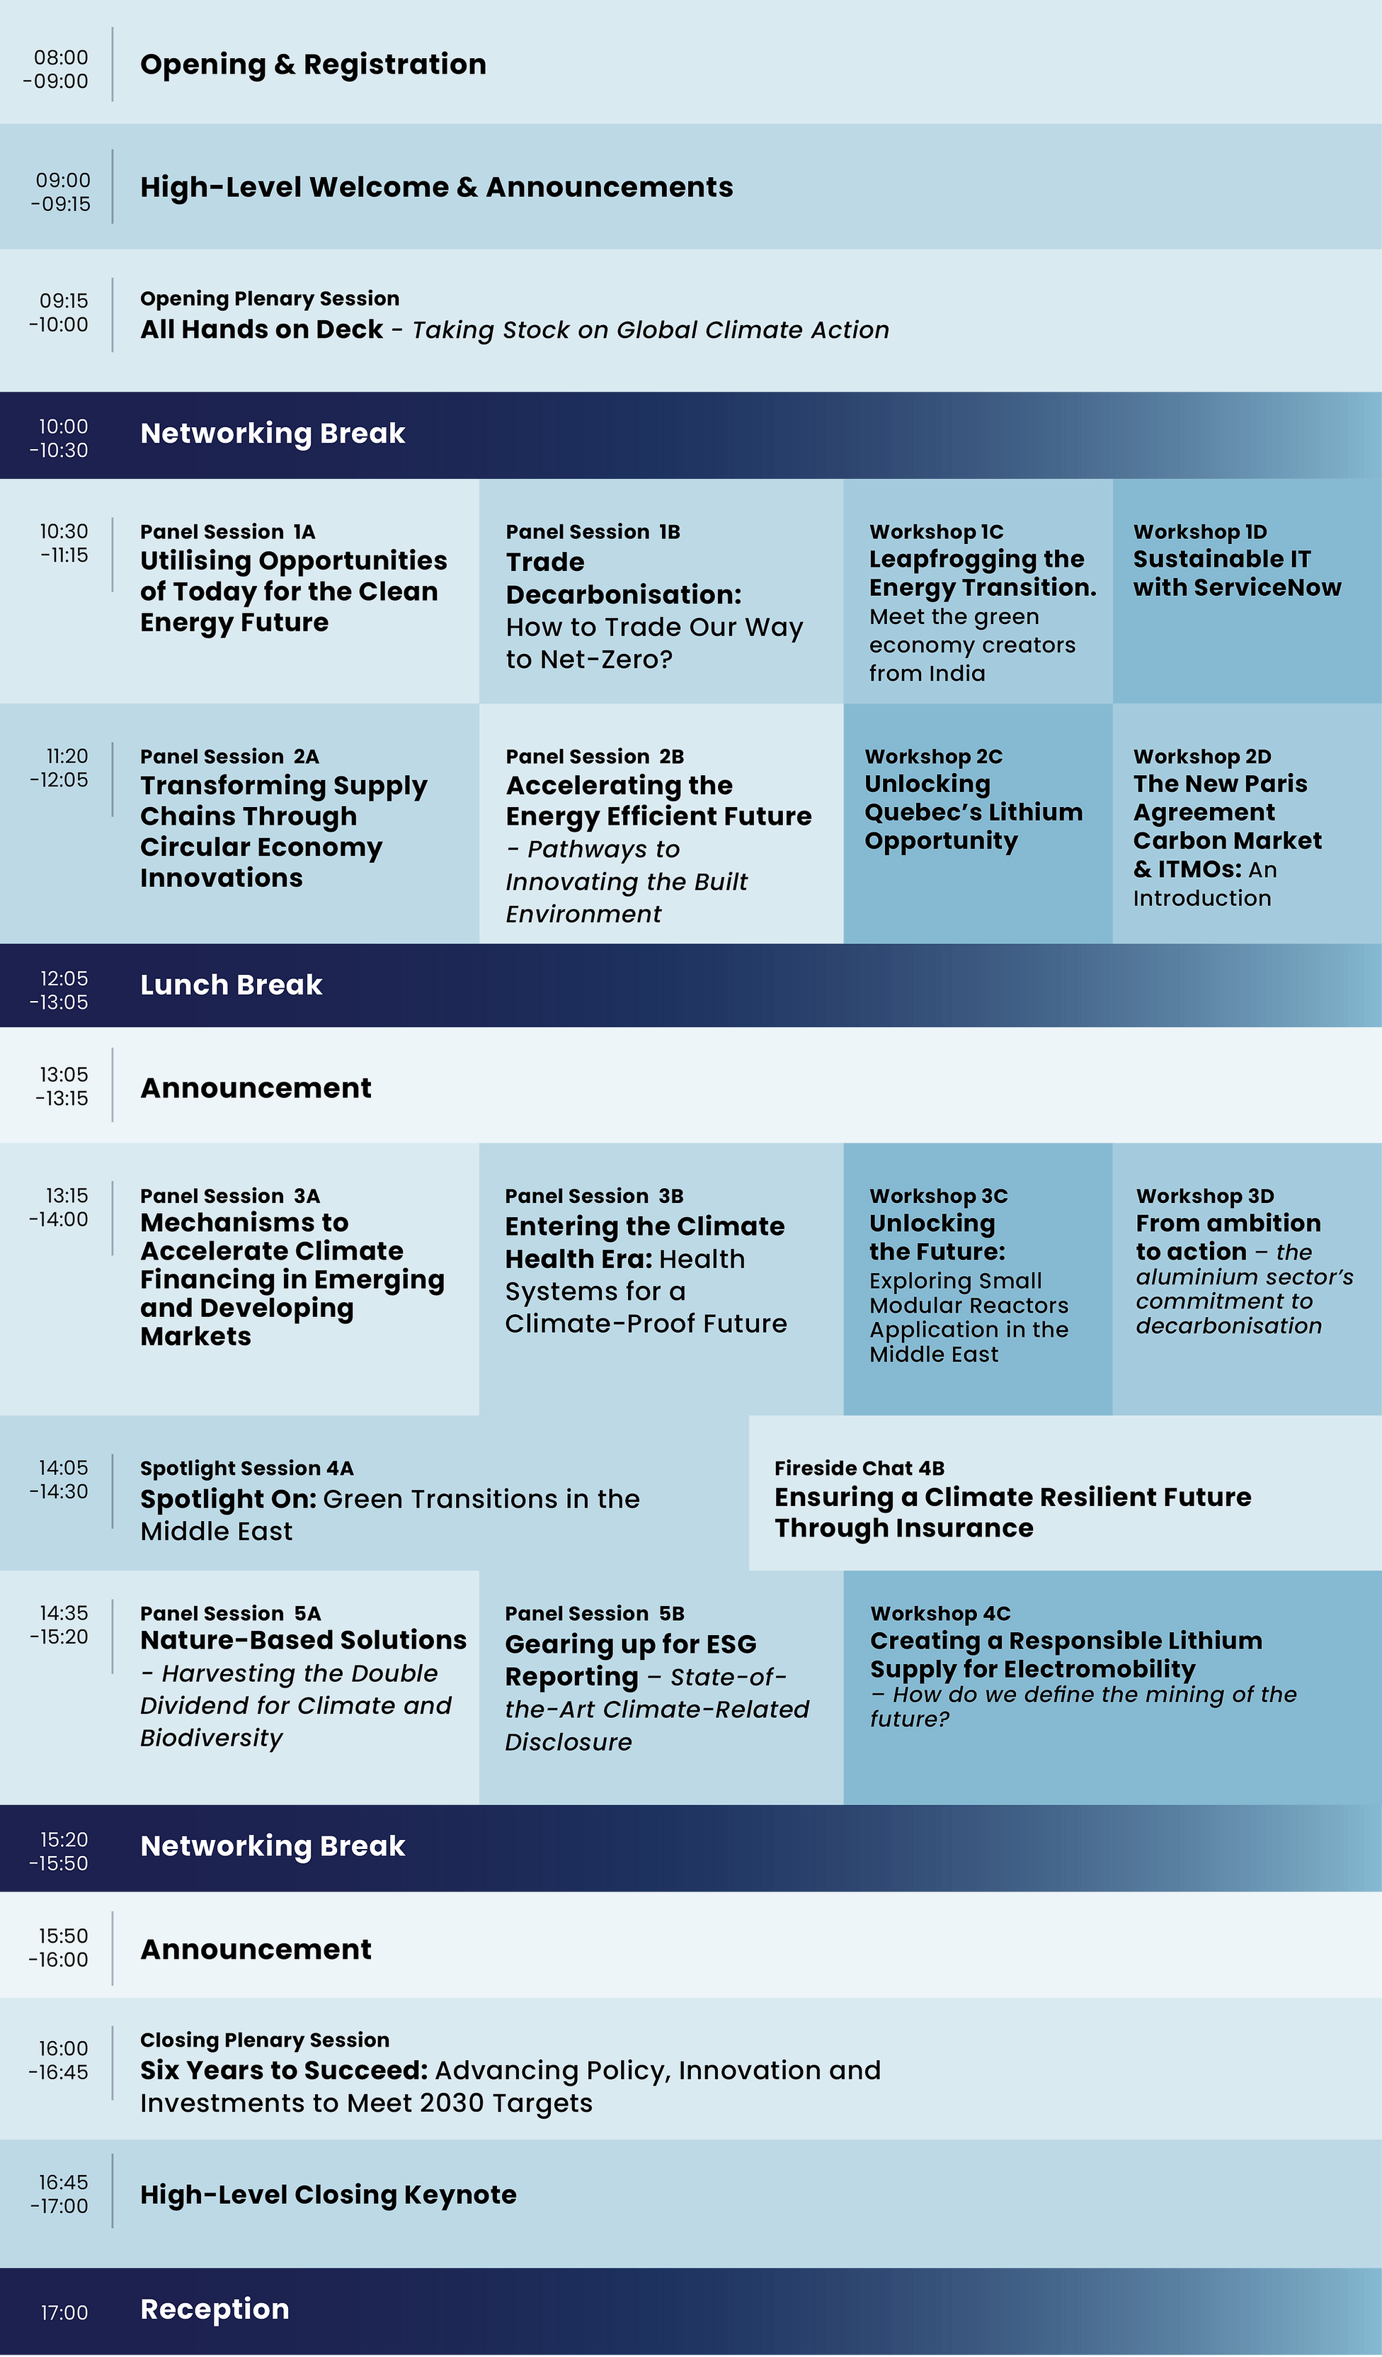
far
  Programme Day 1
  December 7th
far
far
WIFI Name World Climate Summit Password TheInvestmentCOP2023
Notes:
30 sec

Slide 4
far

Slide 5


far
- The investment COP
  7-8 December, Conrad, Dubai
Where Ambition
Meets Action
The Leading Forum for
Public-Private Partnerships
Alongside COP

Slide 6
far
- The investment COP
  7-8 December, Conrad, Dubai
  7-8 December, Conrad, Dubai
Where Ambition
Meets Action
Where Ambition
Meets Action
The Leading Forum for
Public-Private Partnerships
Alongside COP
The Leading Forum for
Public-Private Partnerships
Alongside COP
  7-8 December, Conrad, Dubai

Slide 7
far

Slide 8
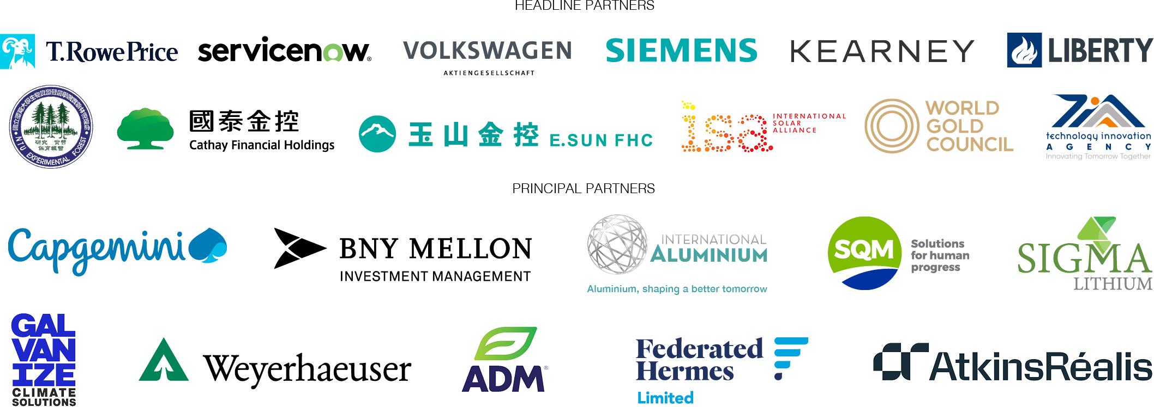
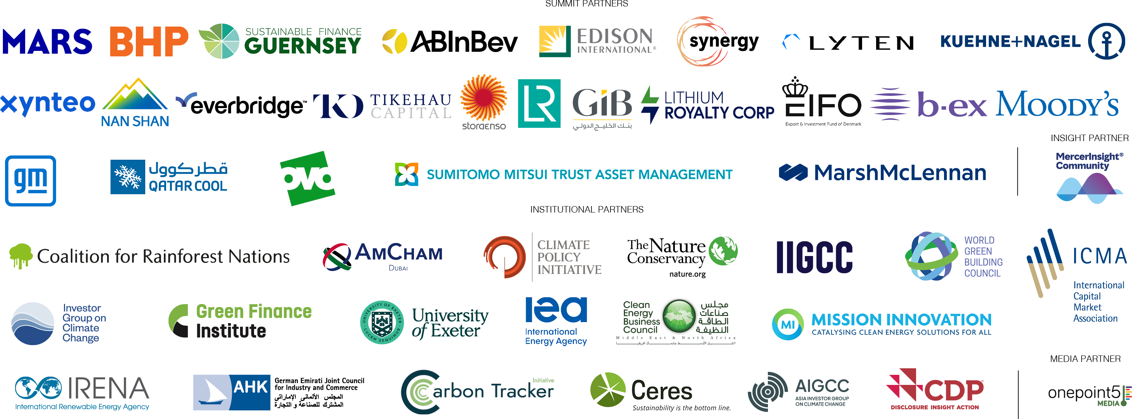
far
  Partners of
  World Climate Summit
Partners of World Climate Summit

Slide 9
far

Slide 10

far
- The investment COP
  7-8 December, Conrad, Dubai
Where Ambition
Meets Action
The Leading Forum for
Public-Private Partnerships
Alongside COP

Slide 11
far
- The investment COP
  7-8 December, Conrad, Dubai
Where Ambition
Meets Action
The Leading Forum for
Public-Private Partnerships
Alongside COP
  7-8 December, Conrad, Dubai

Slide 12
far

Slide 13
far
WIFI Name World Climate Summit
Password TheInvestmentCOP2023

Slide 14
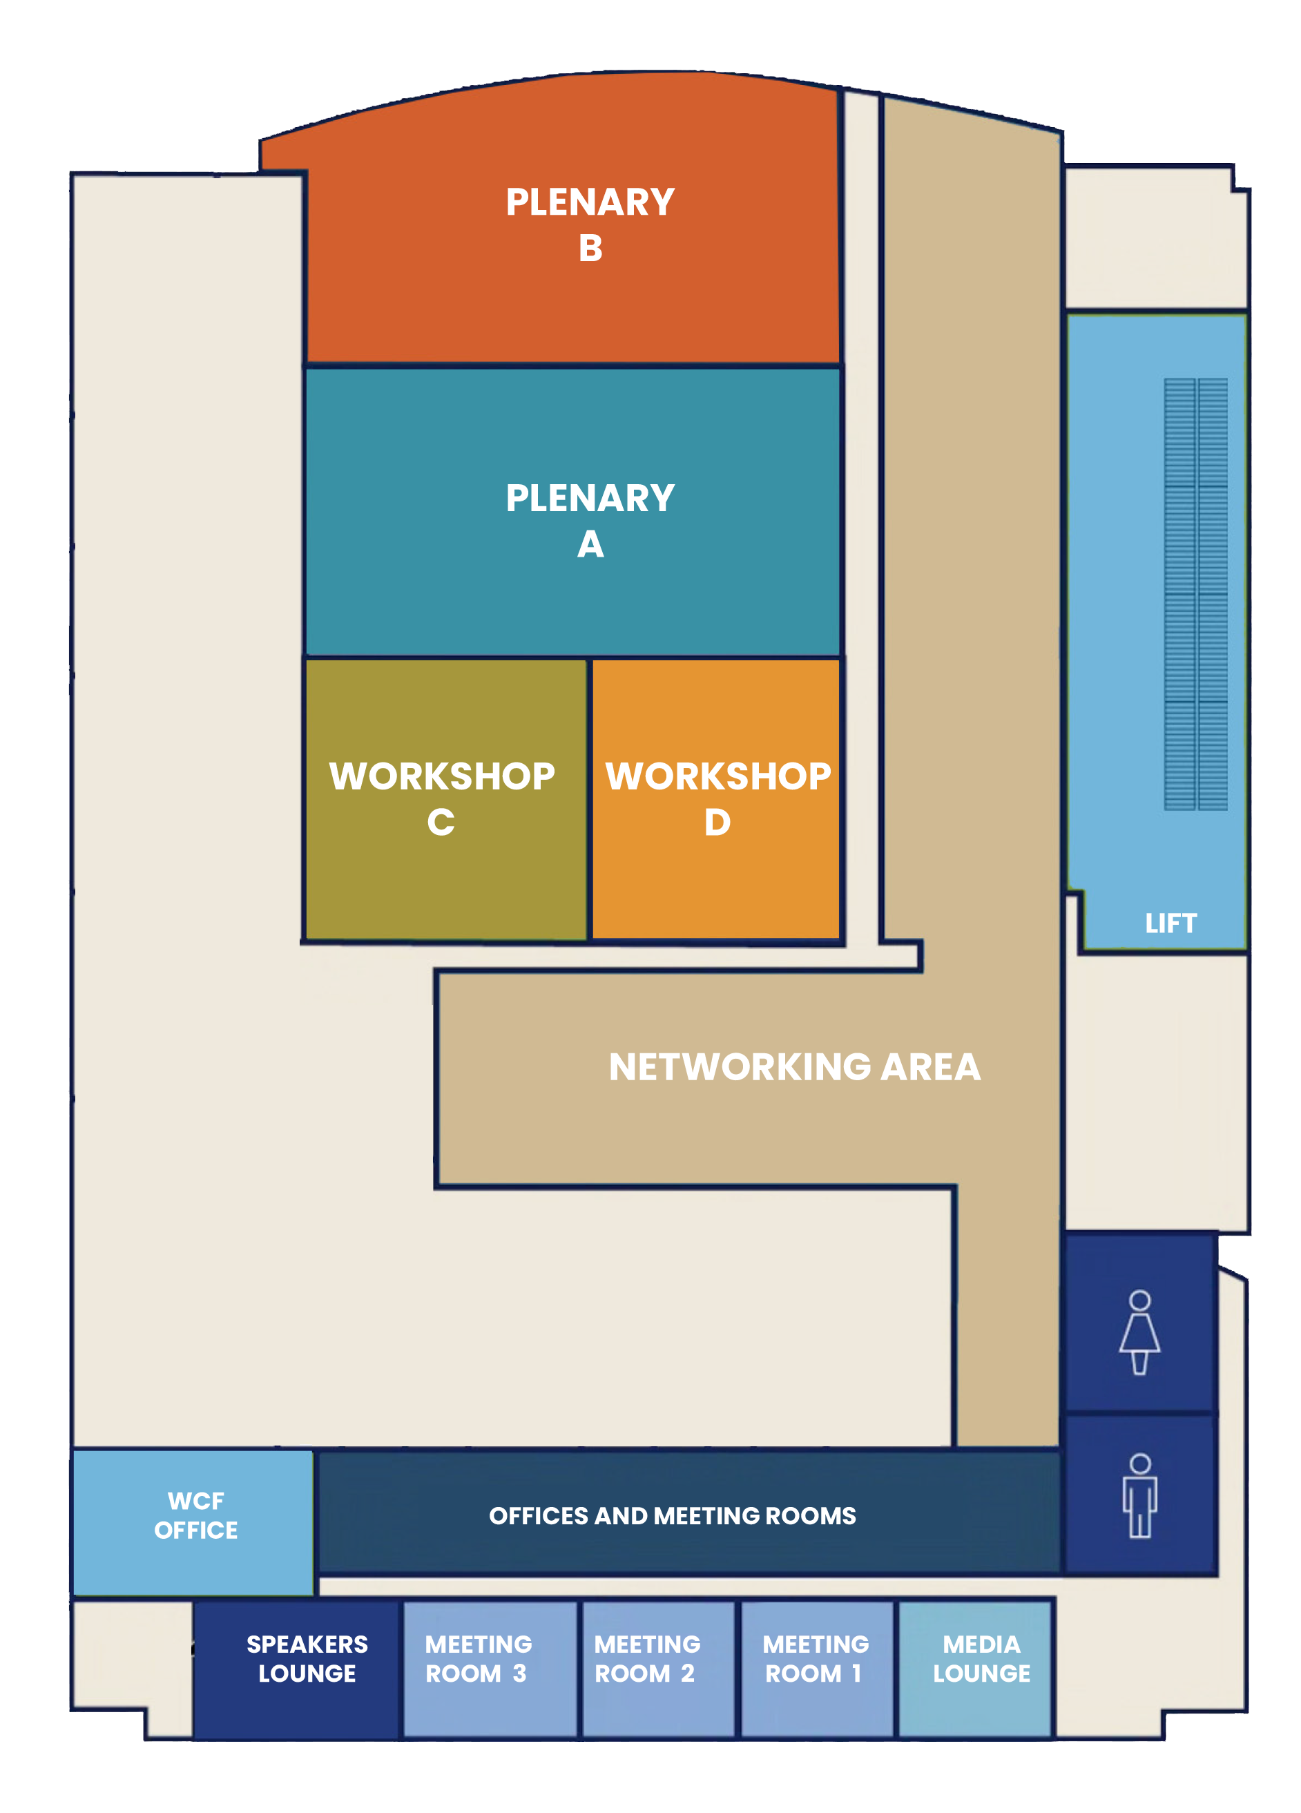
far
  Map of Venue
Notes:
30 sec

Slide 15
far

Slide 16

far
- The investment COP
  7-8 December, Conrad, Dubai
Where Ambition
Meets Action
The Leading Forum for
Public-Private Partnerships
Alongside COP

Slide 17
far
- The investment COP
  7-8 December, Conrad, Dubai
Where Ambition
Meets Action
The Leading Forum for
Public-Private Partnerships
Alongside COP
  7-8 December, Conrad, Dubai

Slide 18
far

Slide 19
far
WIFI Name World Climate Summit
Password TheInvestmentCOP2023

